Slide 1
Analyzing the Social Network Dynamics of Q&A in Stack Overflow User Data
By: Nathan Chapman, Nick Haviland, Gihane Ndjeuha, Andrew Struthers, and Kollin Trujillo,

Slide 2
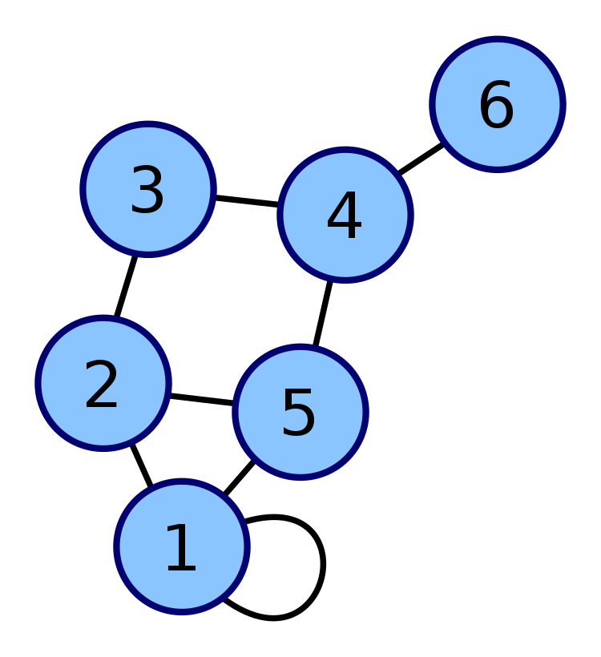
What is a graph?
In its most simplest terms, a graph consists of nodes/vertices and edges/links/arcs.
source: https://commons.wikimedia.org/wiki/File:6n-graph2.svg
Notes:
When talking about a graph we have a few (possible) key structures involved in them.
Connecting nodes/vertices together is an edge, for example the one between 4 and 6.
Then we have a path (or trail), which is a sequence of nodes that are connects any two vertices.
Then we have a cycle, or closed path, which is a closed path that begins and ends at the same node without revisiting the same node.
Consequently an open path is a path where the first and last vertices are distinct.
A loop is an edge that connects a node to itself, for example 1.
Then lastly, the degree of a node is the amount of connections that a node has. For example, node 4 has a degree of 3 whereas node 6 has a degree of 1.

Slide 3
Applications of Graphs
Mention protein-protein interactions. interactomics/connectomics, ecological networks, Crime networks, traffic, and cellular networks,
And in our case, Social networks. We aim to describe the social dynamics of users in Stack Overflow via a user-interaction network.
Notes:
My background is in computational chemistry so I tend to lean into applications in that area. In chemistry, there are so many aspects of chemical theory that can be described by graphs. Some examples include:
Protein-protein interactions
In the space of omics, interactomics/connectomics,
In biological space, ecological networks
In more social science spaces, crime networks, traffic
And in communications, cellular networks.
Graphs are ubiquitous and pop up in nature frequently.
Protein-protein interaction networks…
In networks physical distance is replaced by path length. A path is a route that runs along the links of the network. A path’s length represents the number of links the path contains (Image 2.12a)

Slide 4
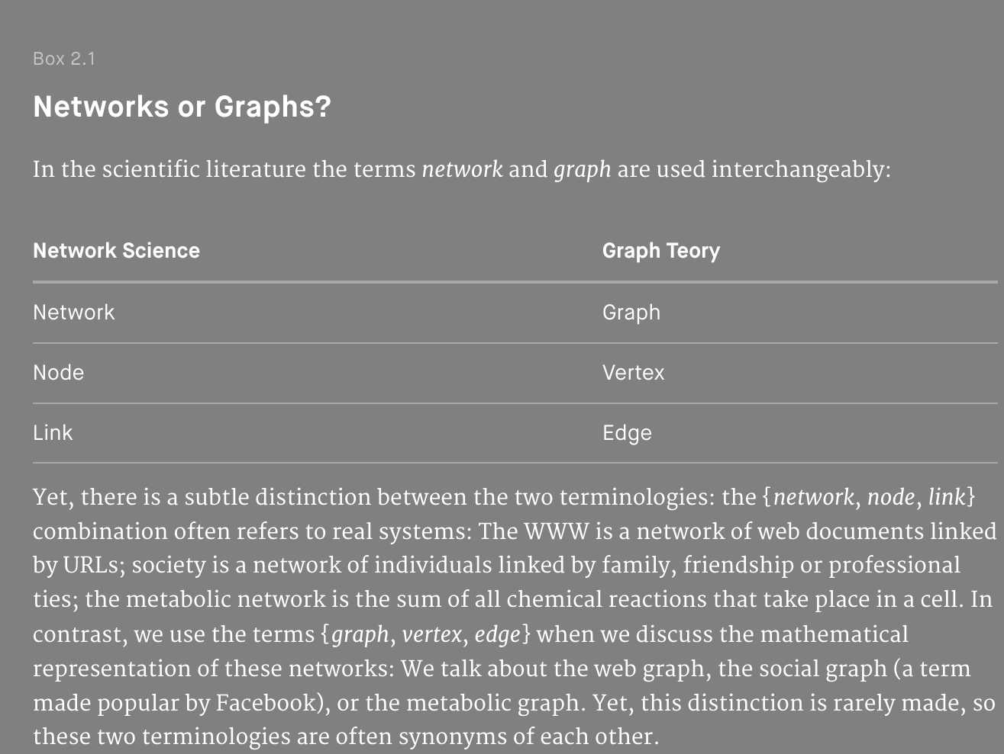
What are networks
Networks are graphs that are…
Networks synonymous with graphs.
Difference in math versus more applied.
Vital in describing everyday interactions.
Adapted from Barabási, & Pósfai, M. (2016).
Notes:
[1]: Barabási, & Pósfai, M. (2016). Network science. Cambridge University Press.
[2]: Zhang, & Horvath, S. (2005). A general framework for weighted gene co-expression network analysis. Statistical Applications in Genetics and Molecular Biology, 4(1), Article17–. https://doi.org/10.2202/1544-6115.1128
Possible second source… gene expression network! Image…
In clarifying the differences between networks and graphs, networks are similar to graphs. However, they tend to have more of an applied slant. And these networks are vital to describing everyday interactions.

Slide 5
Graphs/Networks Are a Part of a More Complex System
Composed of many interconnected parts (dictionary.com)
There are a few key properties used to describe a network [1]:
Degree of a node
Average degree
Degree distribution
There are also different ways how to represent these networks that we have seen in class:
Adjacency matrix
Notes:
This complexity though is what gives rise to the ability to extract meaningful insights from this complexity. We can derive insights from these connections.
When describing networks we can start to look at bigger pictures in its structures. Things like the degree of a node, average degree, and degree distribution give key information about the interconnectivity of the network at a glance. This helps us to understand how much a point is affected by others.

Slide 6
Community Structures
Community structure refers to the tendency for groups of nodes in a network to become more interconnected than the rest of the network
Examples of community structures can be seen without needing to be drawn in a graph: in a social network based around students, those at the same school would be further interconnected
Community structures give insight into the function of the network and provide further insight that can be difficult to see with just a network

Slide 7
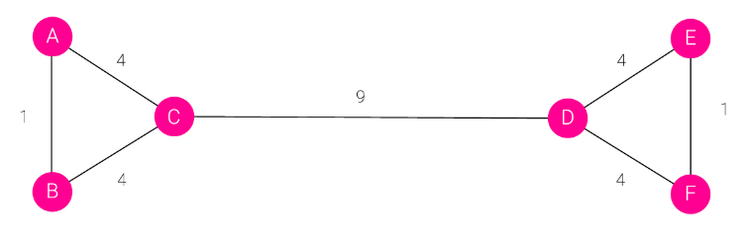
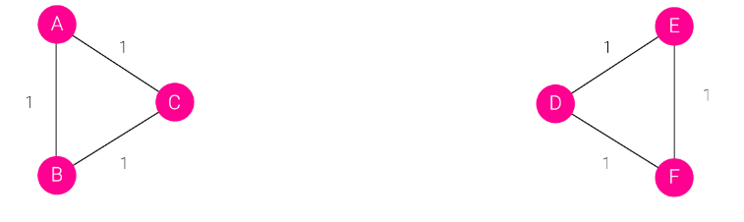
Algorithms for Community Structures
Hierarchical Clustering: Pairs of nodes are evaluated based on some measure of similarity, then grouped as a community if they are similar enough to each other or dissimilar enough to other communities.
Girvan-Newman Algorithm: Finds edges between nodes that connect communities and delete then, leaving communities as separate within the network, example shown below.
Modularity Maximization: Finds a measure of modularity from searching over different possible clusters of nodes within a network. Typically fails to detect small communities

Slide 8
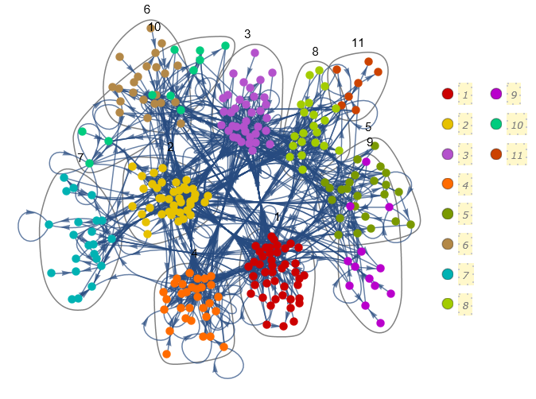
Using Community Structures
In Python, there are numerous packages which implement some of the algorithms previously mentioned, like gervin_newman in networkX or community made packages which implement various algorithms.
Mathematica has a built in function for implementing community structures on a network, CommunityGraphPlot, which can generate community structures or take in user given communities.

Slide 9
Data Selection
Our dataset comes from the Stanford Network Analysis Project (SNAP). This database contains many different network-based datasets
We focused on analyzing network data from https://www.stackoverflow.com specifically to see if we could find any emergent phenomena such as cliques.
Our data is temporal network interactions of users on Stack Overflow
There were 4 different datasets containing this information, each in the format (u, v, t)
User u answered user v's question at time t in the dataset sx-stackoverflow-a2q
User u commented on user v's question at time t in the dataset sx-stackoverflow-c2q
User u commented on user v's answer at time t in the dataset sx-stackoverflow-c2a
Union of all three graphs in the dataset sx-stackoverflow
We focused on examining a small sliver of the data contained in sx-stackoverflow-a2q

Slide 10
Data Selection
sx-stackoverflow contains a total of 2,601,977 nodes and 63,497,050 temporal edges
sx-stackoverflow-a2q has only 17,823,525 temporal edges
Since our goal is to identify some emergent phenomena, such as cliques, we don’t need to visualize all of this data. There is simply too much data to visualize effectively
Looking at the data
25 61 1217627708
59 59 1217627895
72 9 1217628719
61 39 1217629165
36 39 1217629413

Slide 11
Network Visualization via Mathematica
Mathematica has a whole suite of built-in network analysis and visualization features.
For example…

Slide 12
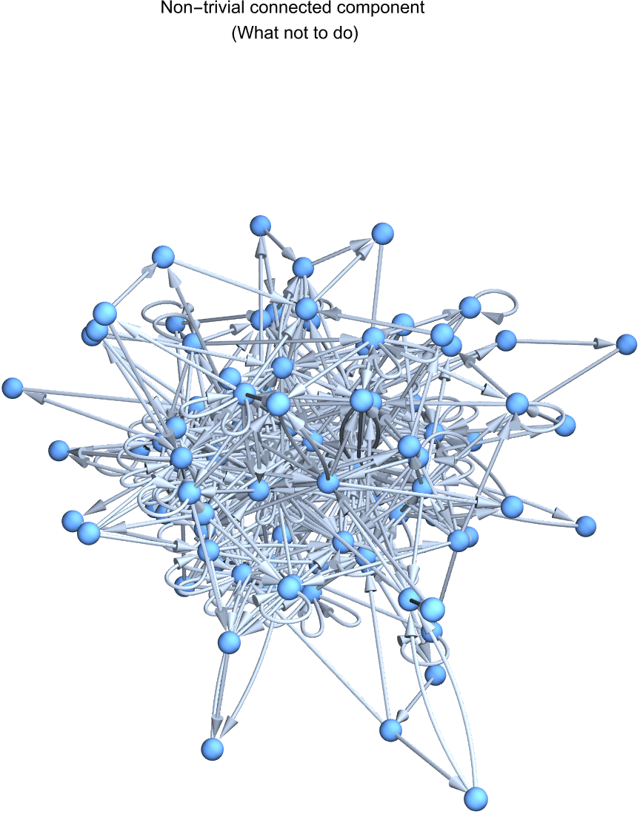
What not to do
3D doesn’t add anything

Slide 13
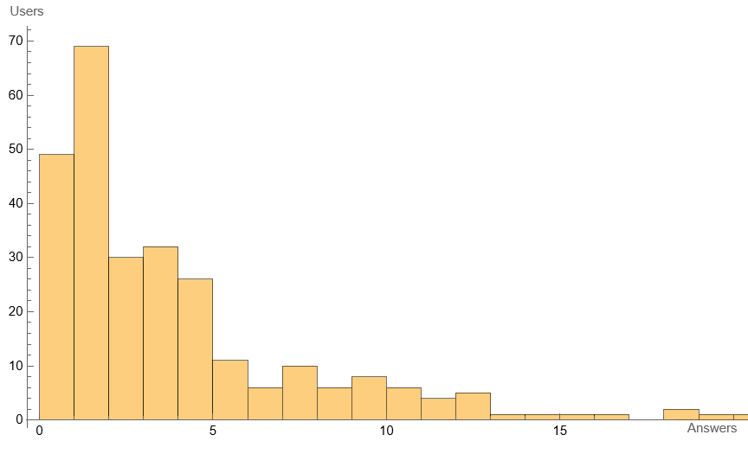
Answering user distribution
Most users that answer questions, answer few

Slide 14

Communities
We already talked about this!

Slide 15
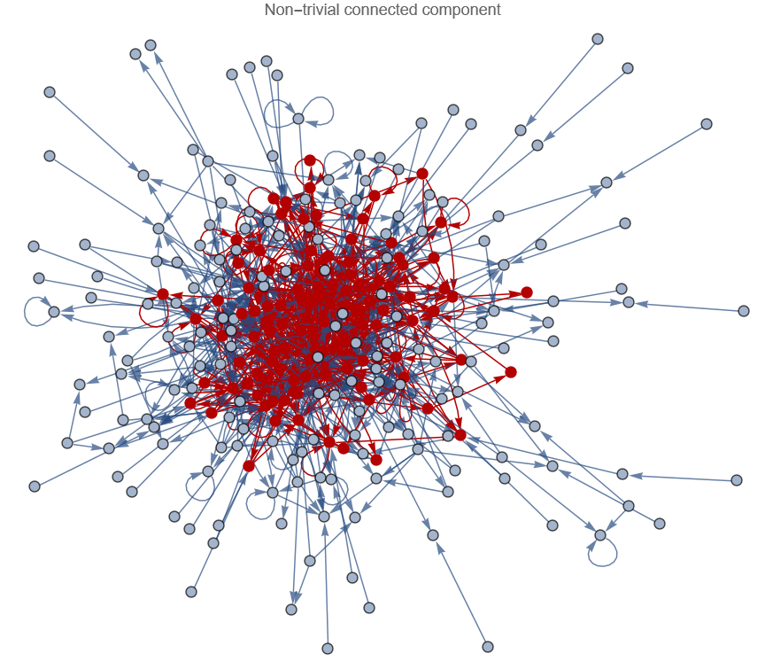
Non-trivial connected component
You can follow links to get from any user to any other user within this set.

Slide 16
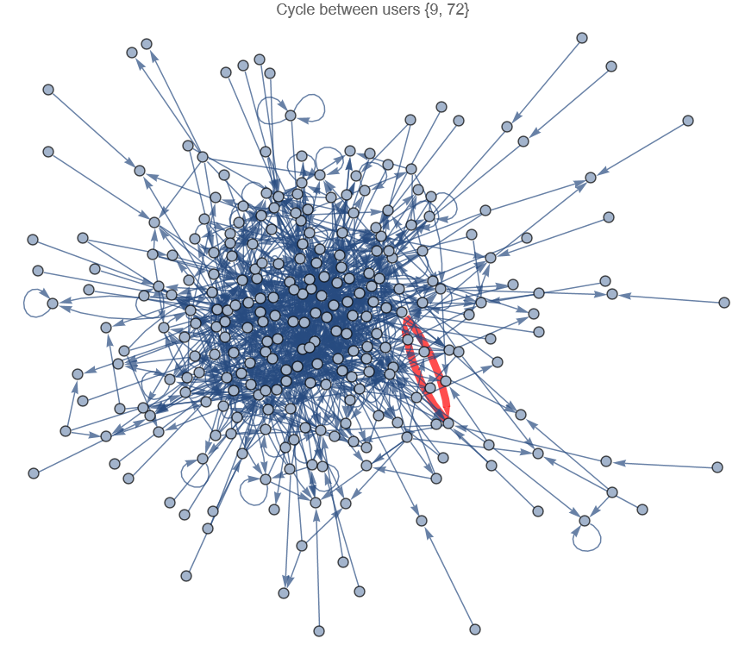
Only a single cycle
Only one instance of two users asking and answering each other’s questions

Slide 17
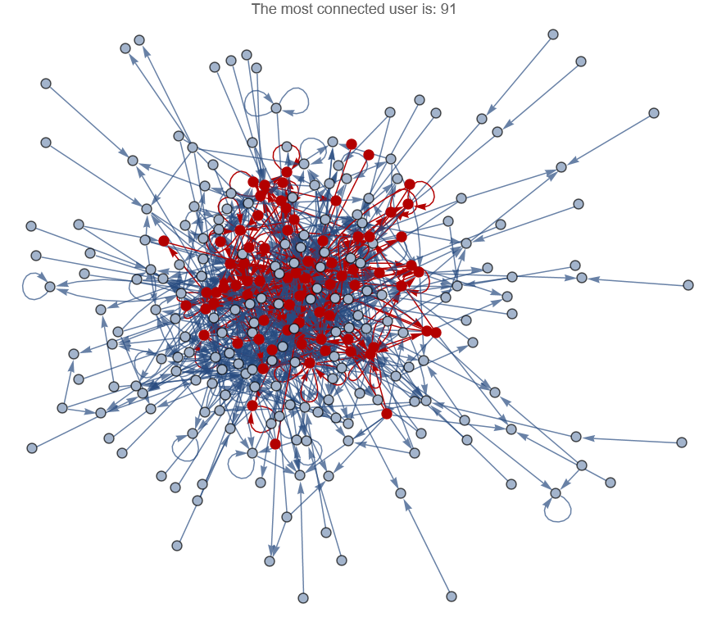
Most connected user
The subgraph of all users that have interacted with this single user

Slide 18
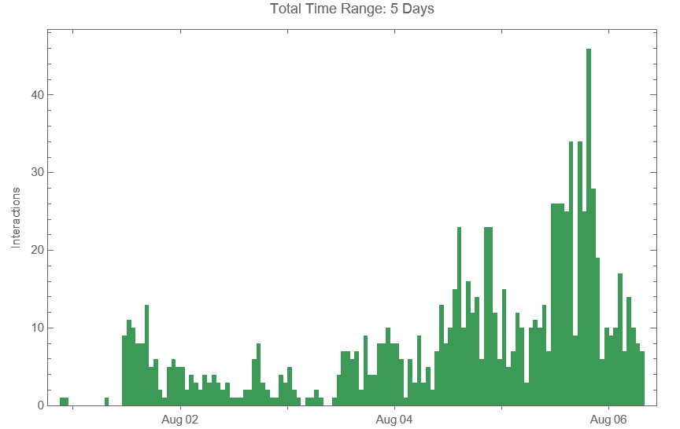
Interactions in each hour
The overall behavior of interactions on the site in each hour

Slide 19
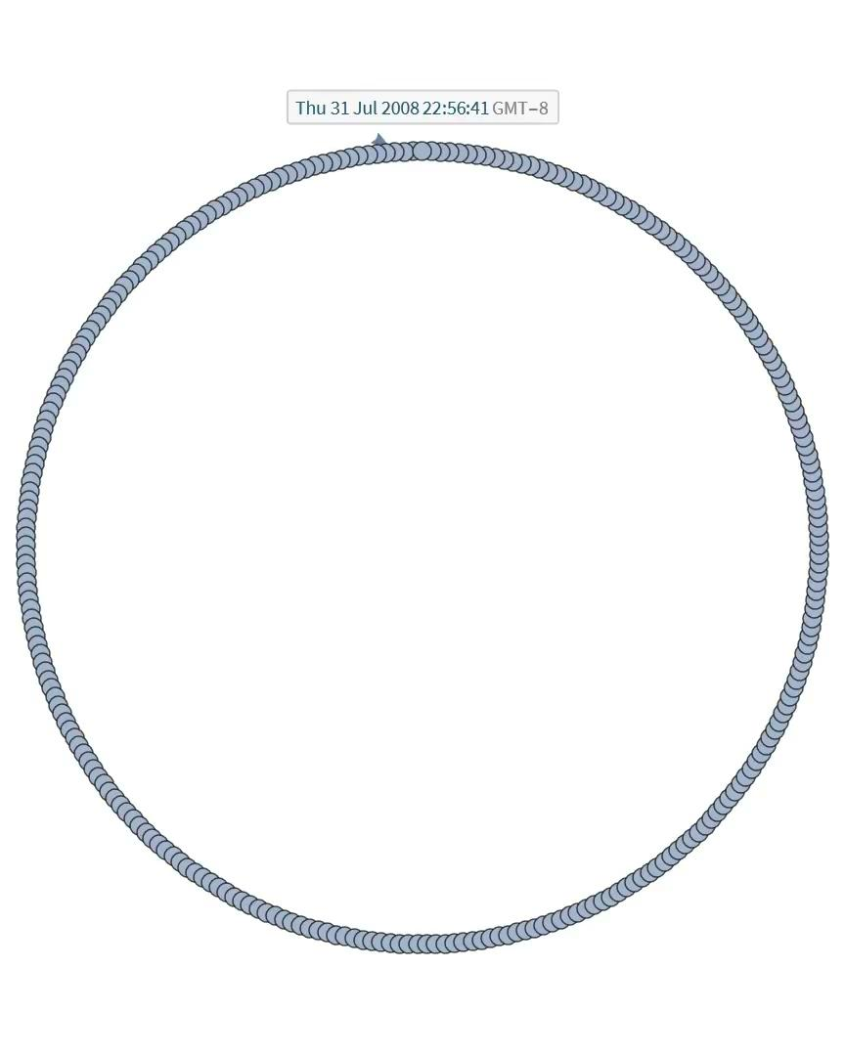
Interaction time-series animation
How the interaction network evolves over time
This video must be CTRL+Left Clicked to view

Slide 20
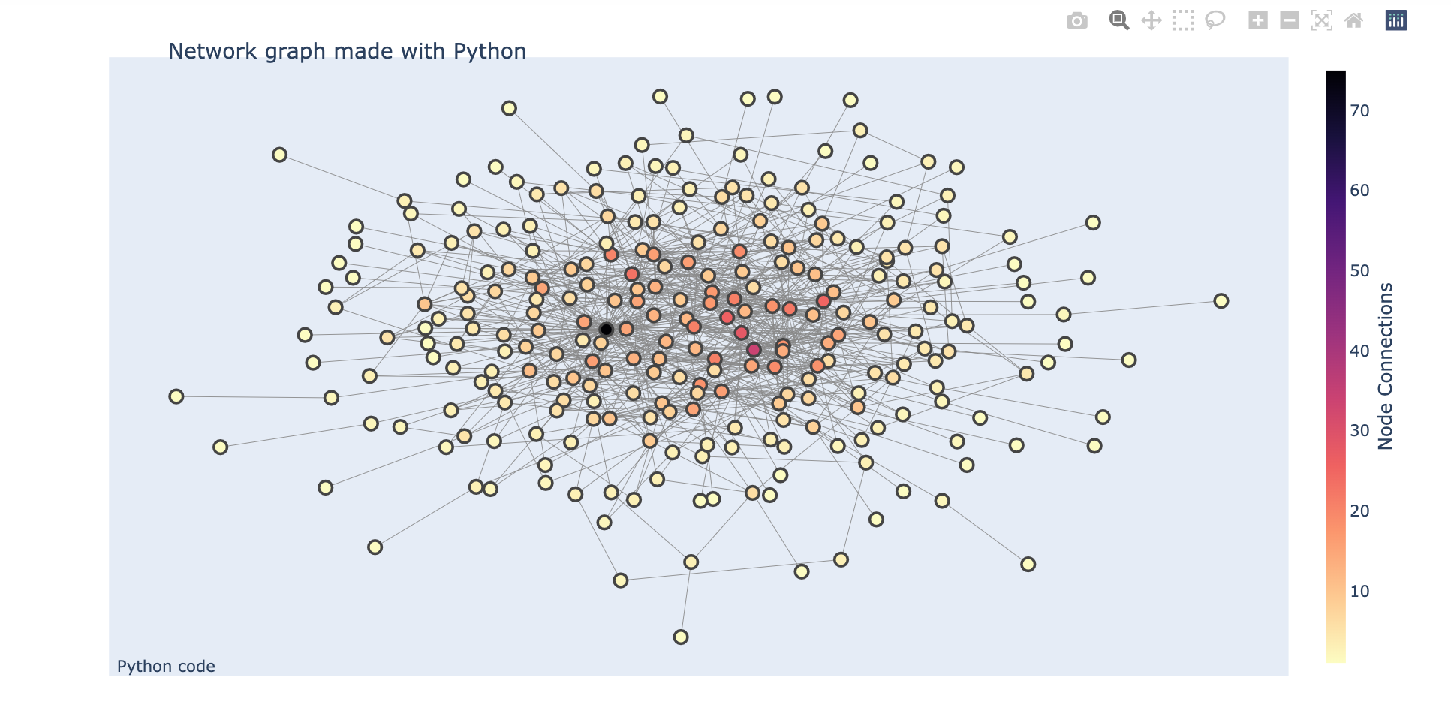
Python Visualization
We also used Python to visualize the data connection from stackoverflow and we got this graph. If we hover on a node, we can see the number of connections that node has; which means the number of interaction each user has with the others users

Slide 21
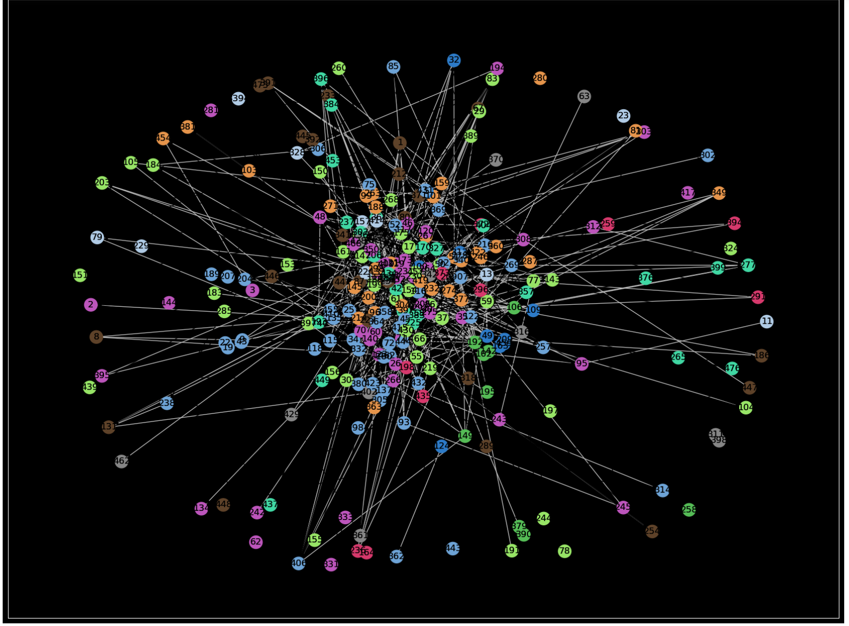
Community visualization
We also used the community structures in python to visualize the data connections. Here we can see a couple nodes with same colors. That represent group of users who didn’t ask or answer any questions, some group represent users who ask or answer few or multiple questions

Slide 22

Interesting Findings
There is only one instance of two people asking and answering each others questions
Person a asked a question that person b answered, then person b asked a question that person a answered
Known as a “cycle”

Slide 23

Interesting Findings
In the time series histogram, the most interactions happen late at night
Typical for programmers to be up in the middle of the night bug fixing
Or the more likely option, people around the world interacting with this site during normal business operating hours in their preferred timezone

Slide 24

Interesting Findings
Most people have low to mid-teen number of answers to questions, but one user in this time frame had more than 70 answers to questions in the 5 days of data we looked at

Slide 25
References
Barabási, & Pósfai, M. (2016). Network science. Cambridge University Press.
Vatsal, Vatsal. “Louvain's Algorithm for Community Detection in Python.” Medium, Towards Data Science, 23 May 2022, https://towardsdatascience.com/louvains-algorithm-for-community-detection-in-python-95ff7f675306.
Despot, Ivan. “Understanding Community Detection Algorithms with Python Networkx.” Memgraph, 23 Mar. 2021, https://memgraph.com/blog/community-detection-algorithms-with-python-networkx.
Wolfram Research (2012), CommunityGraphPlot, Wolfram Language function, https://reference.wolfram.com/language/ref/CommunityGraphPlot.html.
Notes:
I am using APA 7th here. Just citing from auto cite from https://searchlib.cwu.edu/discovery/fulldisplay?docid=alma99322586999501451&context=L&vid=01ALLIANCE_CWU:CWU&lang=en&search_scope=CWU_MORE&adaptor=Local%20Search%20Engine&tab=CWU_MORE&query=any,contains,network%20science,%20ALBERT-LASZLO%20BARABASI&offset=0

